Slide 1


Chapter III - 2025
COPYRIGHT (C) 2025, ECLIPSE FOUNDATION

Slide 2
PITCHING SESSION Criticallities
COPYRIGHT (C) 2025, ECLIPSE FOUNDATION

Slide 3


The Plan
Our plan was to have fun and gain knowledge.
We invested a lot of time in understanding and testing the tools.
Solution and app name was chosen right after the early presentation of the challenge.
A Cruise control that would make you save fuel/energy.

Slide 4
Team and Structure
Our team was chosen to lead our younger members to reach to their peak in a shorter amount of time.
Gain experience when the stress is high and time is short
-Without any impact on productivity, quality or safety

Slide 5
The Product / Service
JACCUS – Just Another Cruise Control Usefull System.
A cruise control that keeps an average speed:
-increased energy saving => bigger authonomy
-bigger delta in max/min speed
-smoother speed change
-increased confort

Slide 6
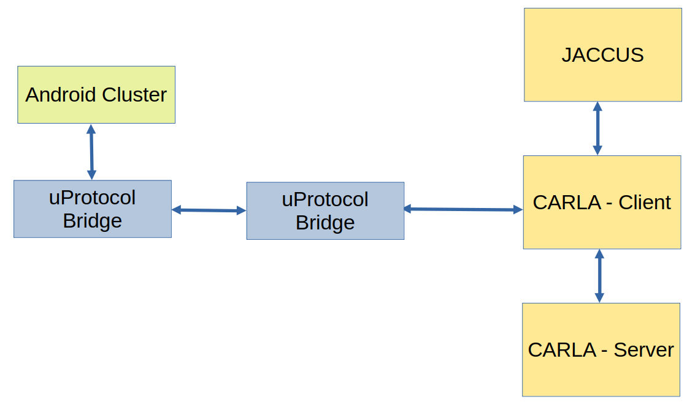
The Product / Service

Slide 7
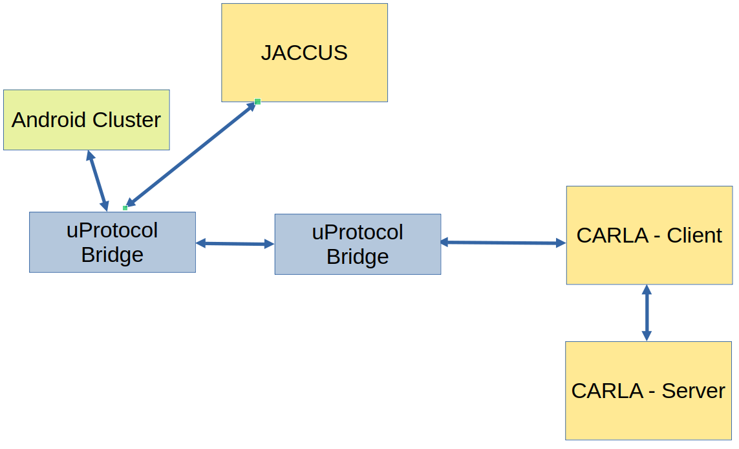
The Product / Service

Slide 8
The Product / Service
JACCUS – Just Another Cruise Control Usefull System.
A cruise control that keeps an average speed:
-increased energy saving => bigger authonomy
-bigger delta in max/min speed
-smoother speed change
-increased confort

Slide 9
The Added Value
The added value is to increase the authonomy of vehicles without compromising the total travel time.
Independent of the engine: electric or ICU.
In the best of our knowledge, no Cruise Control System considers this hypothesis.

Slide 10
The Market & The Competition
Every one enjoys to set a speed, knowingly that it will arrive in a certain time frame, but many avoid it as it consumes more than their own speed control. The closest competitor is the adaptative cruise control who lowers the speed if a car is circulating slower in front of him. But none considers lowering the consumption...

Slide 11
Business Model * Plan & Funds
As true SDVs are still in progress and there aren’t many brands selling them, offering it as a downloadable app is still not feasible.
However, the algorythm can be prepared and improved with the scope of offering the solution as an add on/concept for the main manufacturers
Funds would be used to further develop and improve the app, as well as creating awareness, its own place on the market, and offer the algorythm as a library/feature to be implemented on each brand own vehicle.

Slide 12
Contact
Ana Dias – ana.dias@criticalsoftware.com
André Novo – andre.novo@criticalsoftware.com
Danilo Margarido – danilo.margarido@criticalsoftware.com
João Ferreira – joao.c.ferreira@criticalsoftware.com
Jorge Nunes – jorge.nunes@criticalsoftware.com

Slide 13
Thank You
Critical Minds. Critical Code. Criticallities.
A courtesy of Critical Software.
COPYRIGHT (C) 2025, ECLIPSE FOUNDATION

